Slide 1

OSINT Presentation
By: Kshiragna Challagulla
Abhishek Deshpande Sufyan Khan
Rahul Nagaraju
Josh Reginaldo
Naga Prasath Saravanan
Brahmantya Wardhana

Slide 2
Table of Contents
Team Members, roles and responsibilities within the project
Discuss Project Overview and Scope
The Risk Assessment and Management
Value Analysis-Earned value sheet
View both data collection code and results
Findings/Conclusions, and Future Research
Live Demonstration

Slide 3
Roles in Project:
Project Manager: Sufyan Khan and Prasath
Developers: Josh, Brahmantya, Abhishek
Tester and Analyzers: Josh, Kshiragna Challagundla, Rahul Nagaraju
Risk Management Spreadsheet: Sufyan Khan, Rahul Nagaraju, and Prasath
Earned Value Spreadsheet (evm workbook): Rahul Nagaraju Project Management Plan: Prasath Documentation: Sufyan Khan, Josh, Rahul Nagaraju and Prasath

Slide 4
Project Overview and Scope
Through Research, the OSINT project strives to extract actionable insights from publically available data in order to improve decision-making processes. It comprises crucial steps such as data gathering, analysis, and software program creation geared toward efficient data evaluation from numerous sources.
Project Scope:
Application Focus: Developing flexible software that is originally built for basic functionality but may be expanded for future expansions.
Data Sources: Using the Exchange Rate Converter, Crypto Coin Price, Sunrise Sunset Data, and Simple Country Data APIs, key data from currency and geographical data sources is shown.

Slide 5



Team Communication
Discord, as a multifunctional tool, allows group communication by providing message, calling, and information sharing features. Furthermore, we used numerous Google applications, allowing for discussion on many aspects of the project and promoting smoother contact among all team members. Throughout the project's lifetime, both Discord and WhatsApp were critical in supporting successful communication and cooperation.

Slide 6
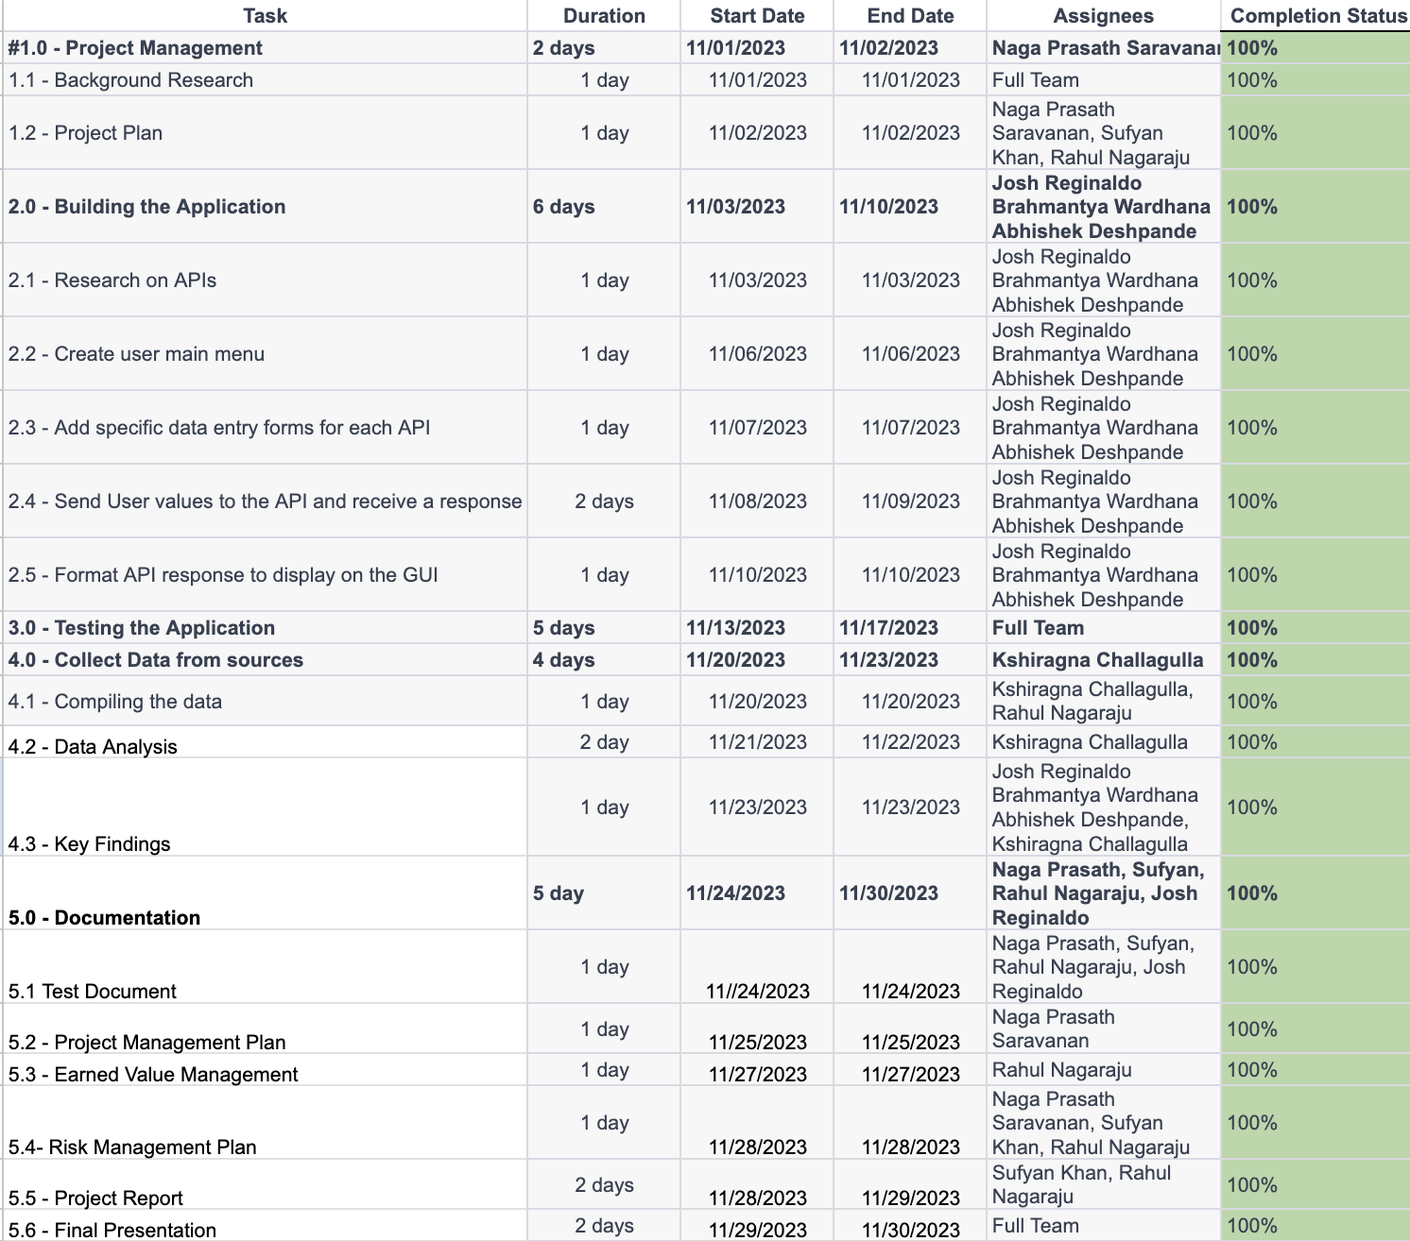
Project Management Plan

Slide 7
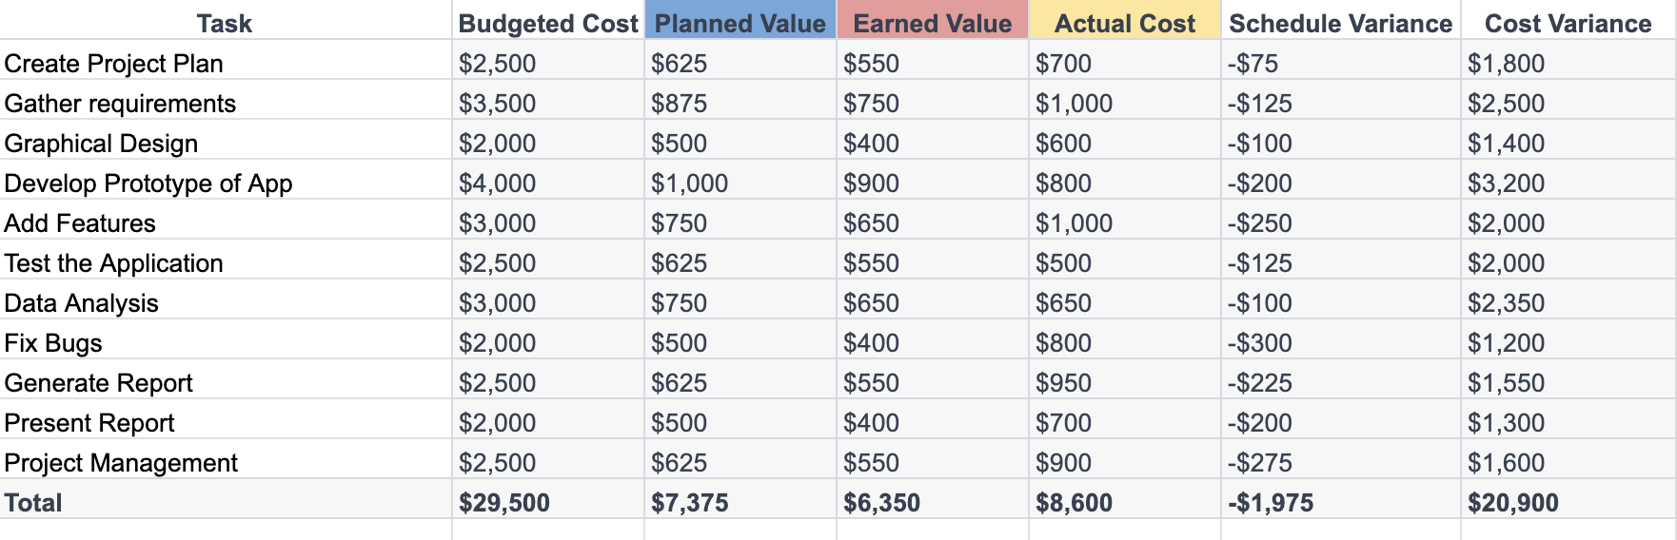
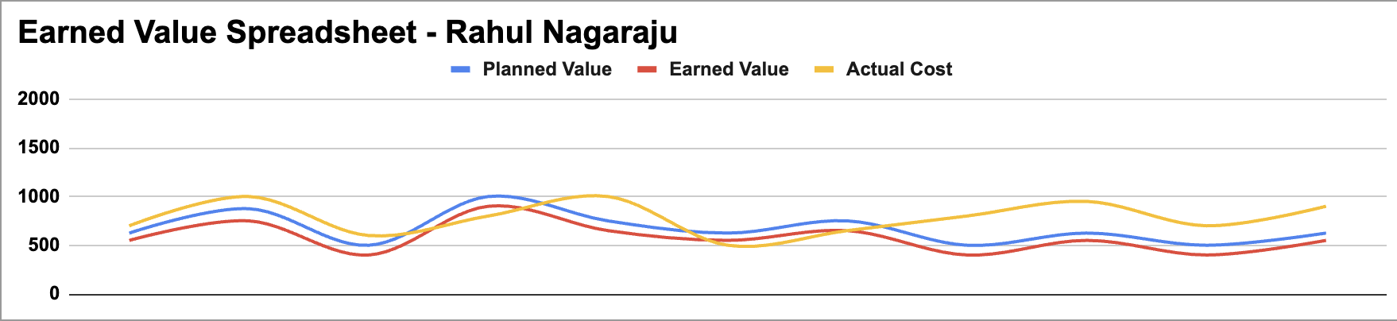
Earned Value Report (Value Analysis)

Slide 8
Risk Assessment and Risk Management
Identifying Risks: Before starting the project, we carefully looked for things that could go wrong, expecting problems that might slow us down.
Assessing Risk Likelihood: We sorted out what issues were more likely to happen, helping us focus on what needed attention the most.
Evaluating Risk Impact: We figured out how bad each problem could be for our project goals, making it easier to understand what might happen if things went wrong.
Mitigation Strategy: We came up with smart ways to handle and lessen problems, making sure we were ready if something went off track.
Continuous Vigilance: We kept an eye out for any weaknesses or issues that popped up during the project, fixing them as we went along to keep everything running smoothly.

Slide 9
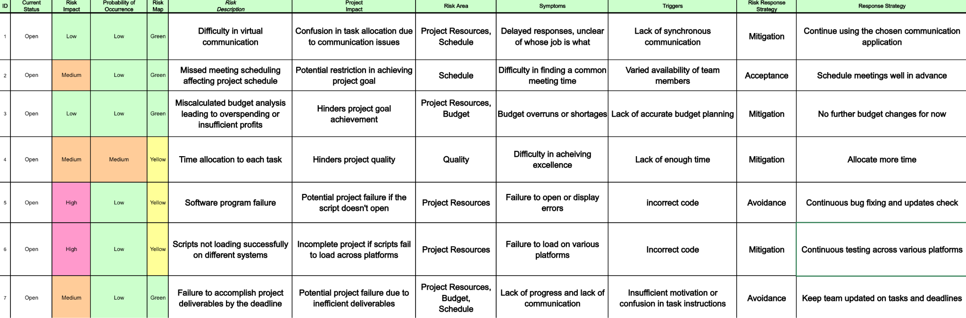
Risk Management Log (Photo and Explanation)

Slide 10
Application and API Implementations
Developed using Python and Tkinter as the GUI
APIs:
CoinMarketCap: Cryptocurrency Prices
ExchangeRate-API - CurrencyConverter API
REST Countries
SunriseSunset.io: Find Sunrise and Sunset Times Anywhere
This application leans more towards a “general purpose” application that can be either further developed or integrated with a bigger application

Slide 11
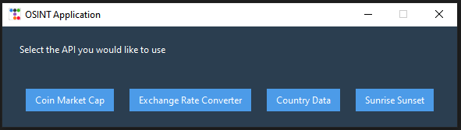
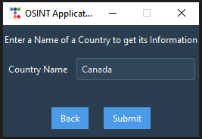
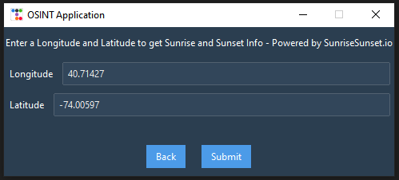
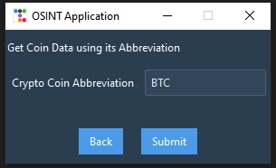
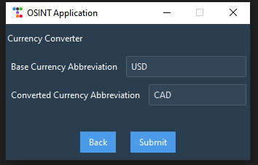
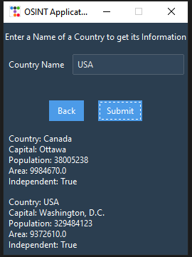
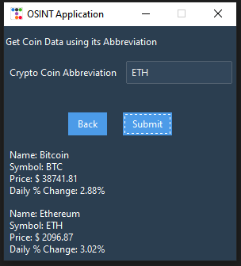
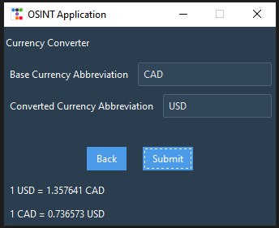
Application GUI

Slide 12
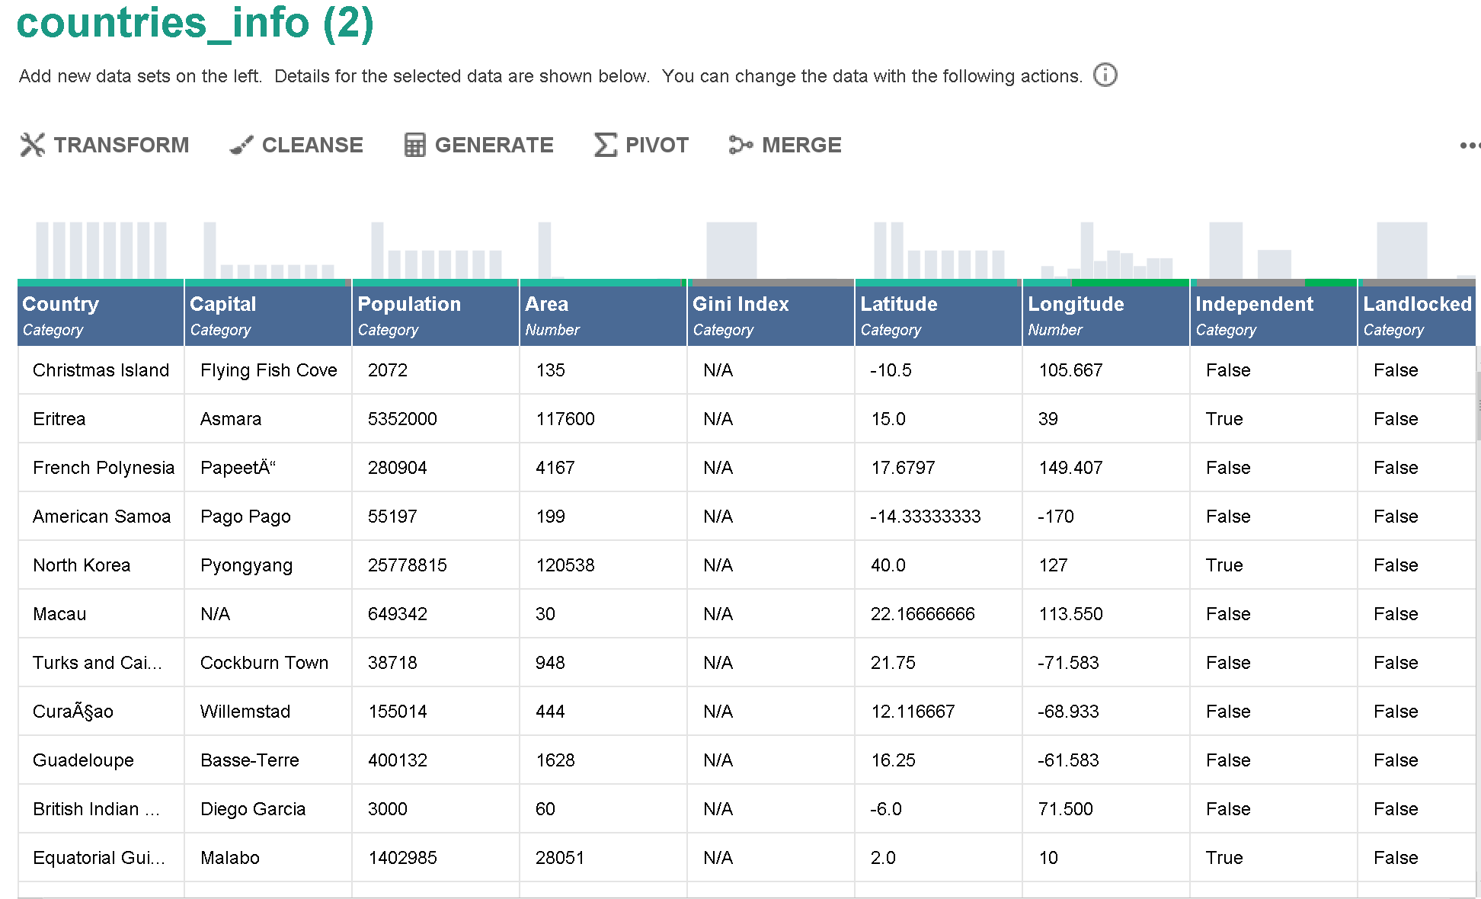
Countries Information Analysis
I have used RapidMiner Studio to perform the analysis on the data set related to Countries information.

Slide 13
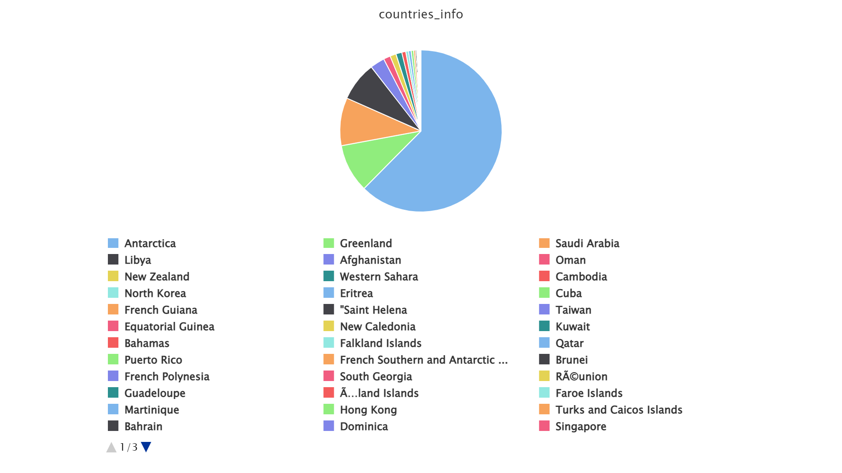
Countries Information Analysis
This pie chart depicts the information regarding different countries with their respective area.
Notes:
In the given pie chart the country Antarctica covers the maximum area of 14,000,000 sq.km, Greenland 2,166,086 sq.km, Saudi Arabia 2,149,690 sq.km, Libya 1,759,540 sq.km and so on.

Slide 14
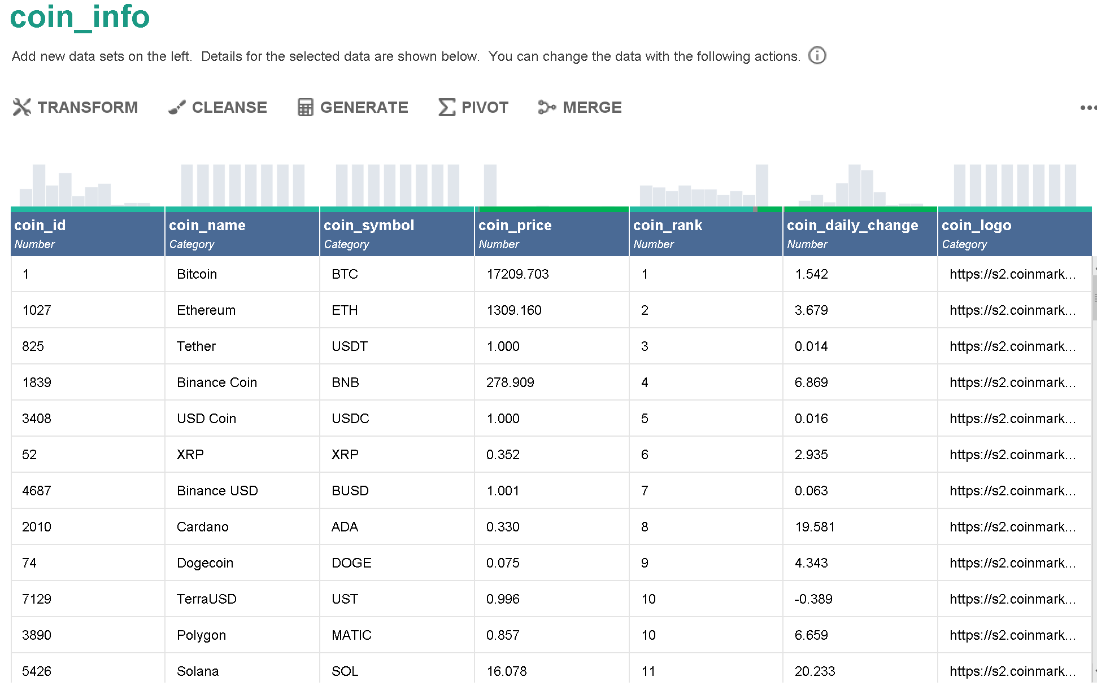
Coin Information Analysis
I have used RapidMiner Studio to perform the analysis on the data set related to Coin information.

Slide 15
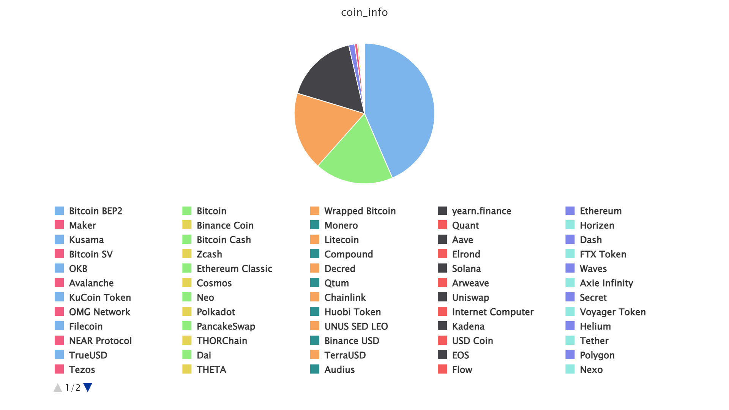
Coin Information Analysis
This pie chart depicts the information regarding different coins with their respective prices.
Notes:
In the given pie chart the coin Bitcoin BEP2 holds the maximum price of 41,337 $, Bitcoin 17,210 $, Wrapped Bitcoin 17,202 $, yearn.finance 15,869 $ and so on.

Slide 16
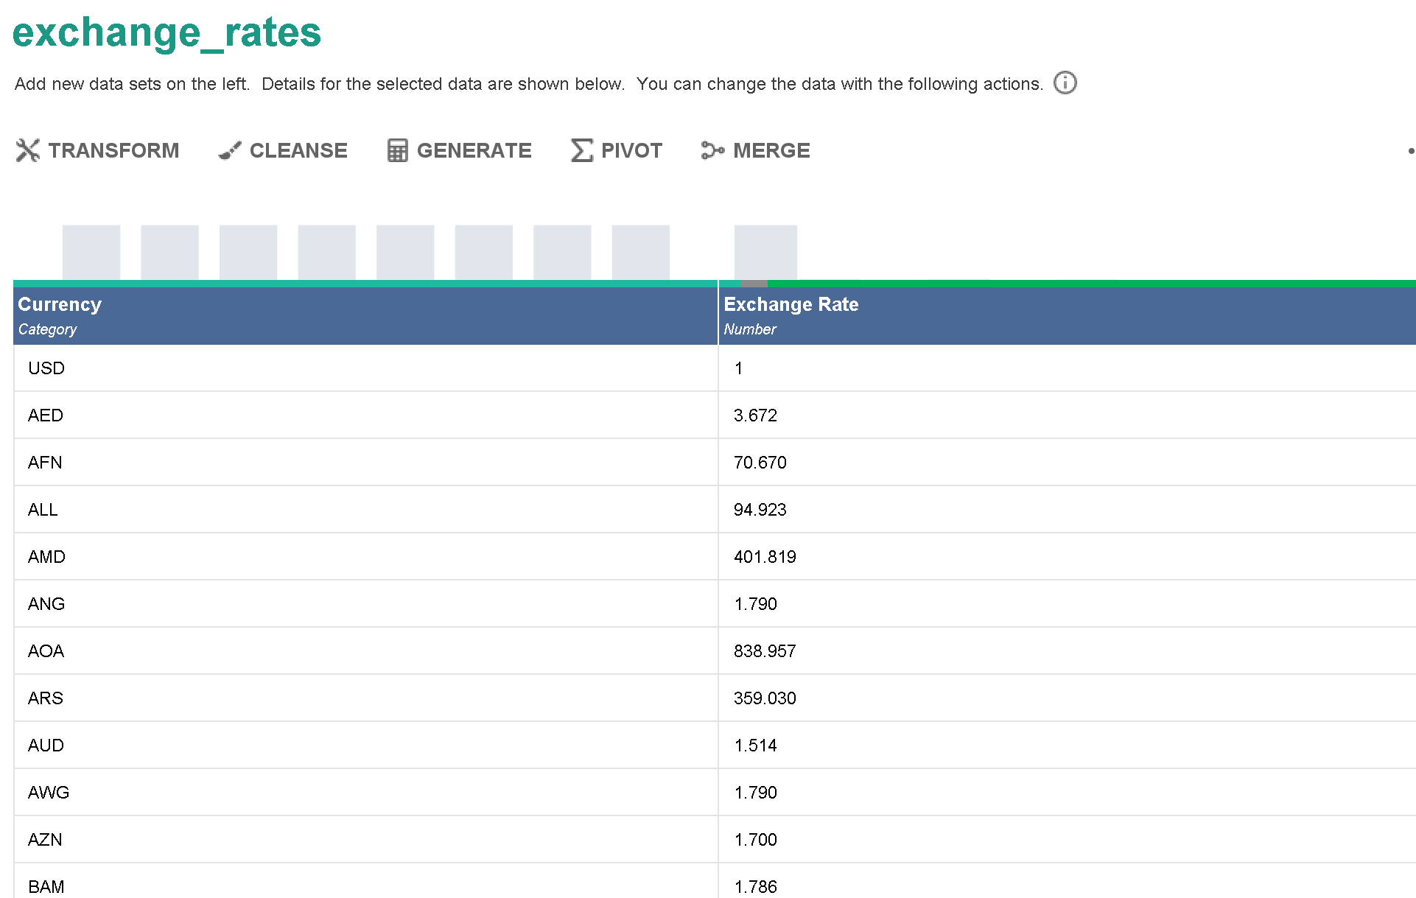
Exchange Rates Analysis
I have used RapidMiner Studio to perform the analysis on the data set related to Exchange Rate information.

Slide 17
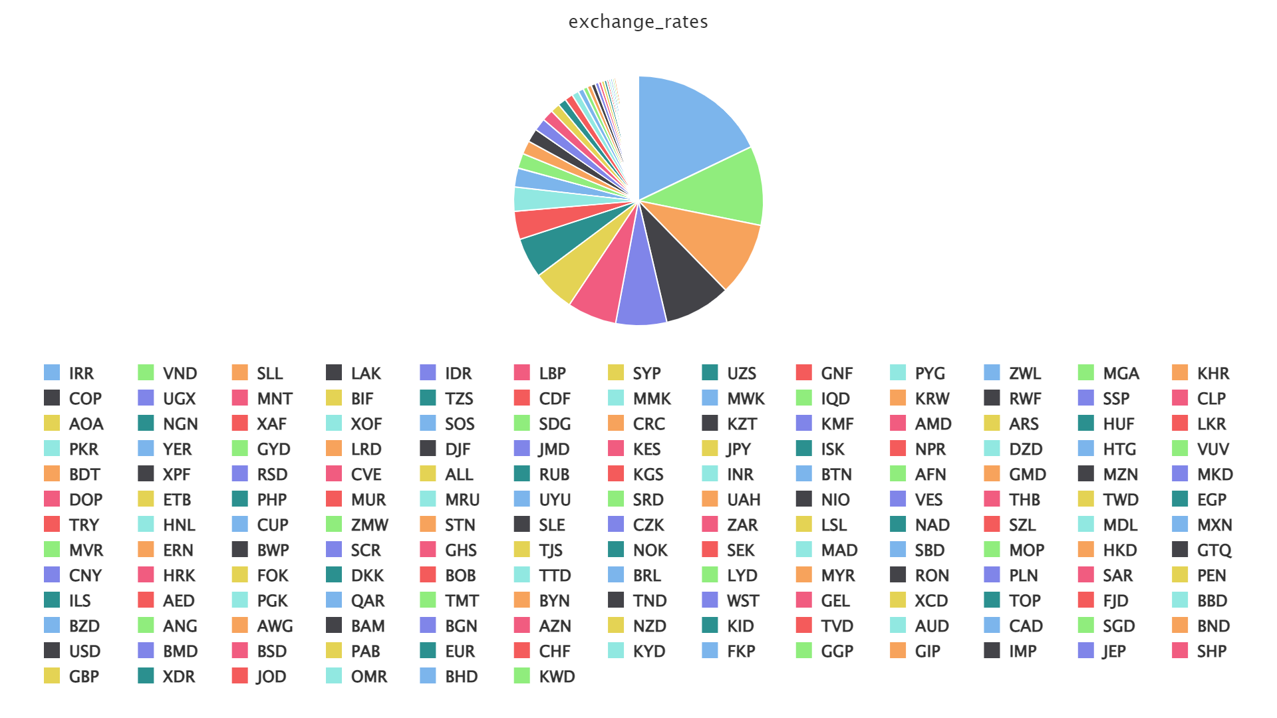
Exchange Rates Analysis
This pie chart depicts the information regarding different currency with their respective exchange rates.
Notes:
In the given pie chart the currency IRR holds the maximum exchange rate value of 41,939, VND 24,182, SLL 22,313, LAK 20,286, IDR 15,489 and so on.

Slide 18
Thank you!

